Slide 1
CS 4476/6476 Spring 2020
PS1
Harry He
Gyrocopterfaith@hotmail.com
2433338

Slide 2
1.1 Use numpy.random.rand to return the roll of a six-sided die over N trials.
def prob_1_1(N):
"""
Args: N: the number of trials.
Returns: arr: array of rolls.
"""
rn = np.random.rand(N)
arr = np.floor(rn * 6) + 1
return arr
1.2 Let y be the vector: y = np.array([11, 22, 33, 44, 55, 66]). Use the reshape command to form a new matrix z that looks like this: [[11,22],[33,44],[55,66]]
def prob_1_2(y):
"""
Args: y: numpy array.
Returns: z: numpy array of shape (new_size,2).
"""
z = y.reshape(-1, 2)
return z

Slide 3
1.3 Use the numpy.max and numpy.where functions to set x to the maximum value that occurs in z (above), and set r to the row number (0-indexed) it occurs in and c to the column number (0-indexed) it occurs in.
def prob_1_3(z):
"""
Args: z: numpy array of shape (3,2).
Returns: x: max value in z.
r: row index of x.
c: column index of x.
"""
x = np.max(z)
r, c = np.where(z == x)
r, c = r[0], c[0]
return (x, r, c)
1.4 Let v be the vector: v = np.array([1, 4, 7, 1, 2, 6, 8, 1, 9]). Set a new variable x to be the number of 1’s in the vector v.
def prob_1_4(v):
"""
Args: v: numpy array.
Returns: x: number of 1’s in v.
"""
x = np.count_nonzero(v == 1)
return x

Slide 4
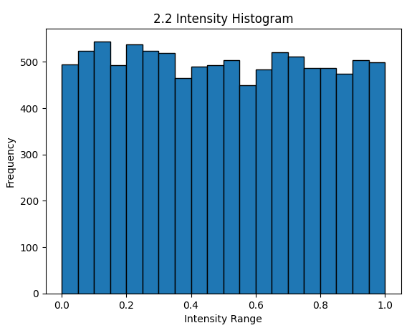
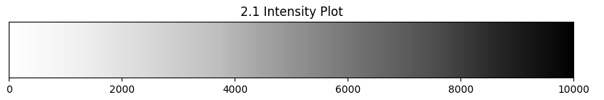
2.1 Plot all the intensities in A, sorted in decreasing value. Provide the plot in your answer sheet. (Note, in this case we don’t care about the 2D structure of A, we only want to sort the list of all intensities.)
2.2 Display a histogram of A’s intensities with 20 bins. Again, we do not care about the 2D structure. Provide the histogram in your answer sheet.
Insert plot here
Insert plot here

Slide 5
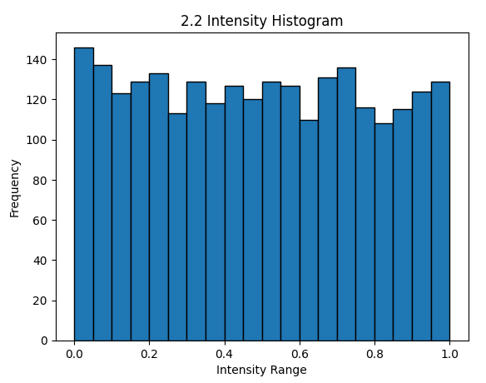
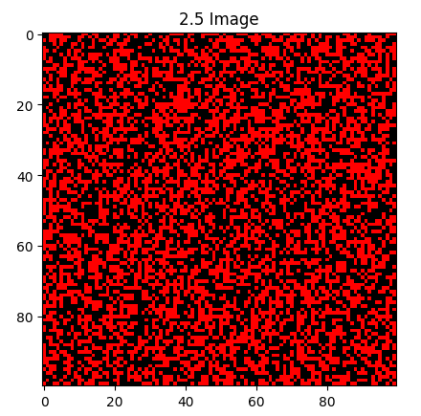
2.3 Create and return a new matrix X that consists of the bottom left quadrant of A (Use function 2.3 and return X. Provide the histogram in your answer sheet.
2.5 Create and return a new matrix X that consists of the bottom left quadrant of A (Use function 2.3 and return X. Provide the histogram in your answer sheet.
Create and return a new matrix Z that represents a color image the same size as A, but with 3 channels to represent R, G and B values. Set the values to be red (i.e., R = 1, G = 0, B = 0) wherever the intensity in A is greater than a threshold t = the average intensity in A, and black everywhere else. Provide the image Z in your answer sheet.
Insert plot here
Insert plot here

Slide 6
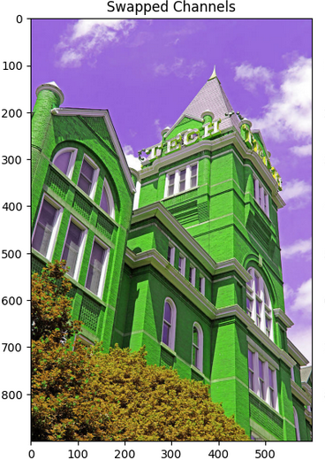
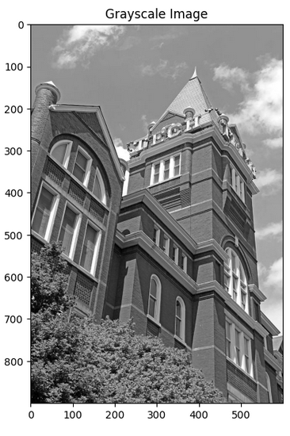
3.1 Display the color channel swapped image.
3.2. Display the grayscale image.
Insert image here
Insert image here

Slide 7
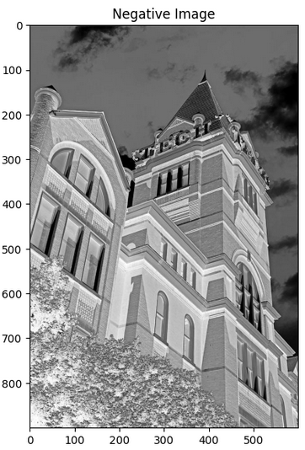
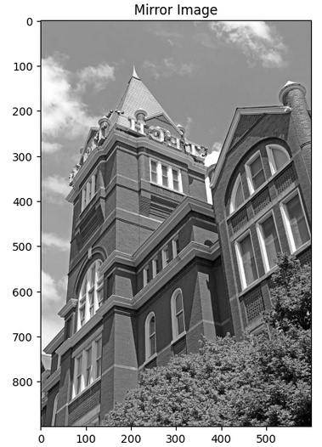
3.3 Display the negative image.
3.4 Display the mirror image.
Insert image here
Insert image here

Slide 8
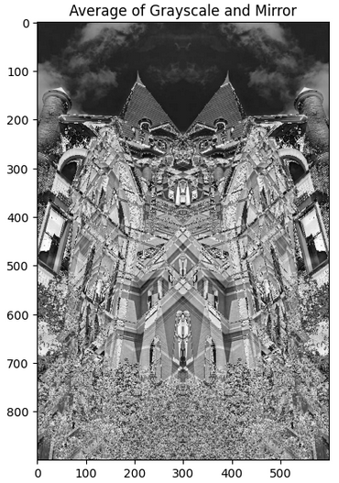
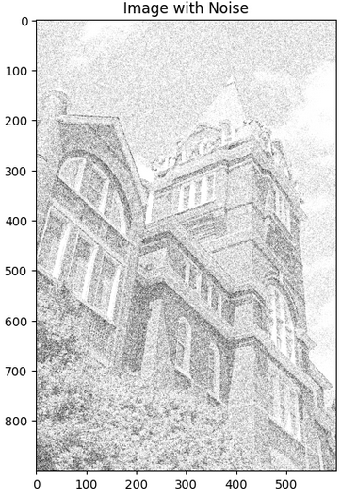
3.5 Display the averaged image.
3.6. Display the clipped image.
Insert image here
Insert image here

